Slide 1

E-Commerce Data Vault
Rayan Hassan, Soumyae Tyagi
DS5110 – Intro to Data Management Section 04

Slide 2
Introduction
Goals
Design a robust and scalable data warehousing solution that integrates both user reviews and product metadata
Create a ChatBot that can answer all types of questions about a given product

Slide 3
Methodology
Data Visualization
ChatBot
Why ?
Facilitate access to reviews and product metadata.
Help the company understand review trends and analyze product data.
How ?
Use of Flask to create dashboards.
Analyze price and rating distribution.
Importance ?
Companies can use this visualization to predict optimal product and discount price, study seasonal trends, etc.
Why ?
Easy access to product information.
Helping customer answer any questions they might have.
How ?
Use of GROQ API to connect with Llama3 model.
Use of Streamlit to create interactive UI.
Importance ?
Reducing search time for customers providing fast answers.

Slide 4
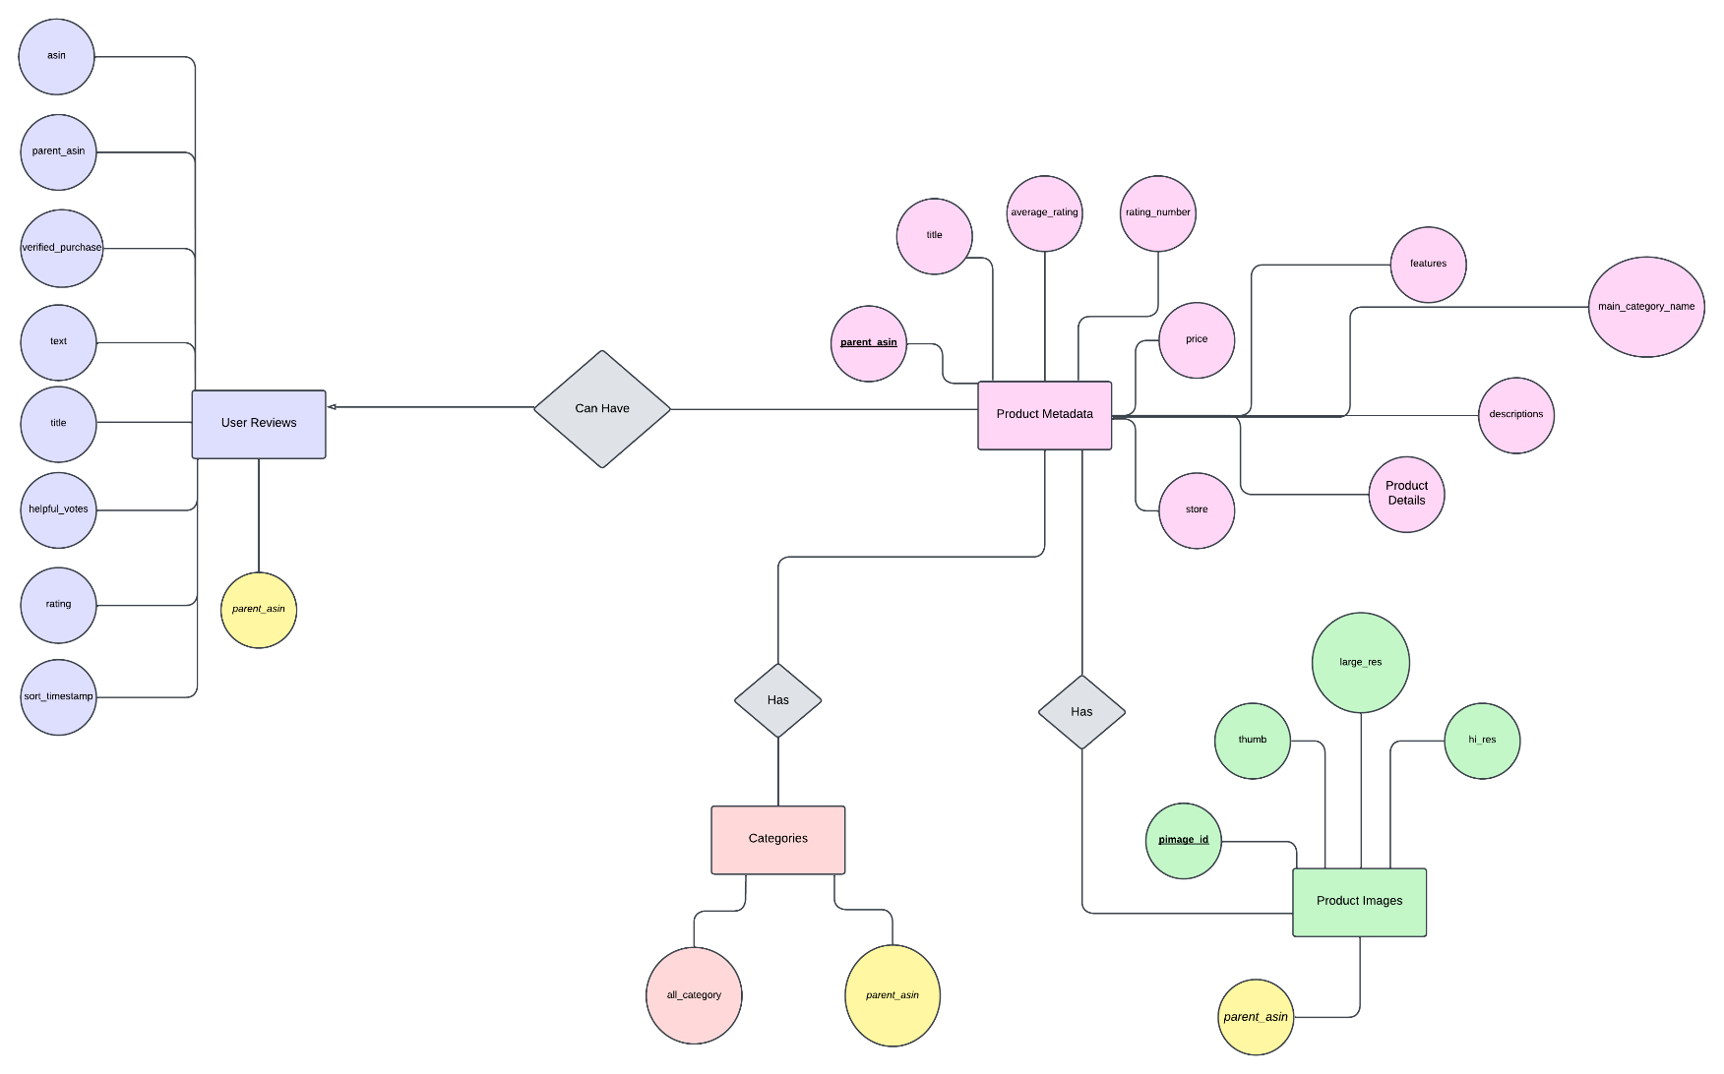
ERD

Slide 5
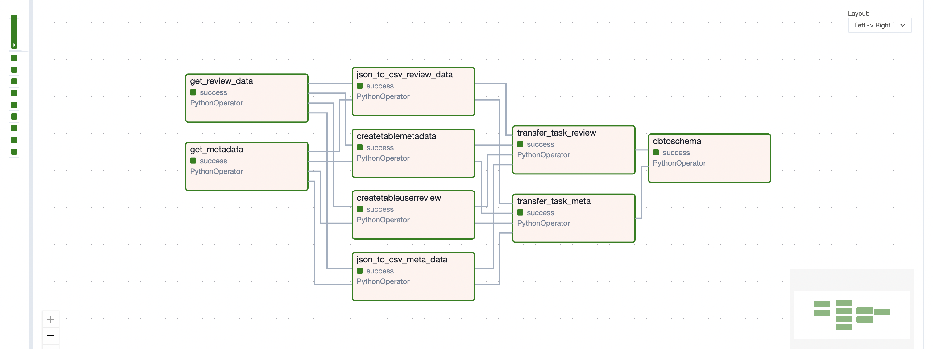
Data Pipeline for Adding/Uploading Data (Apache Airflow)

Slide 6
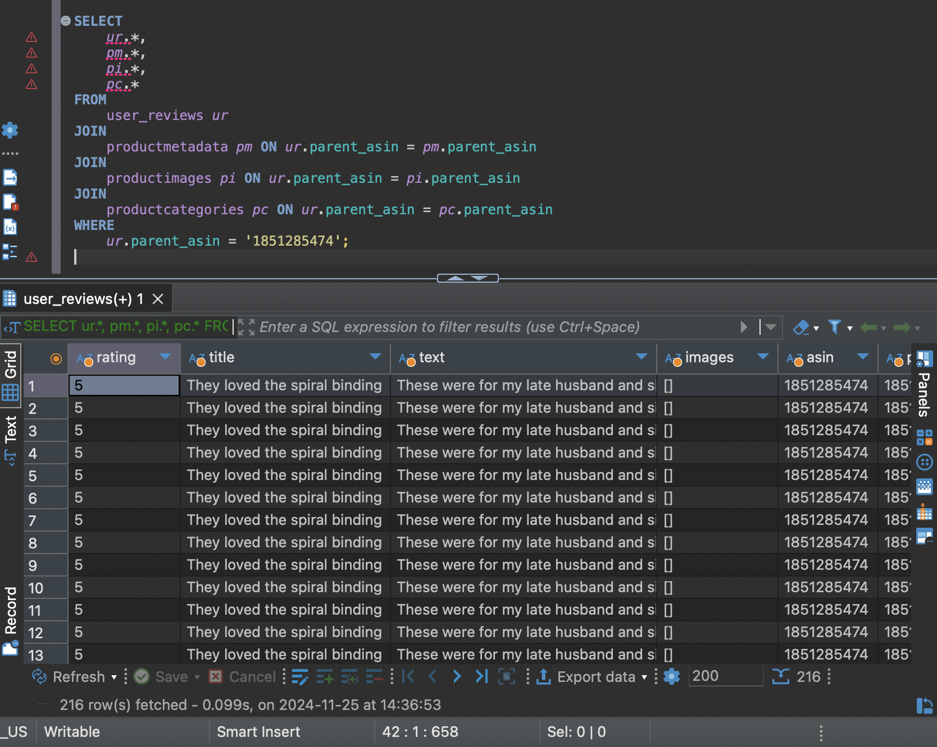
SQL Queries – Retrieving Data

Slide 7
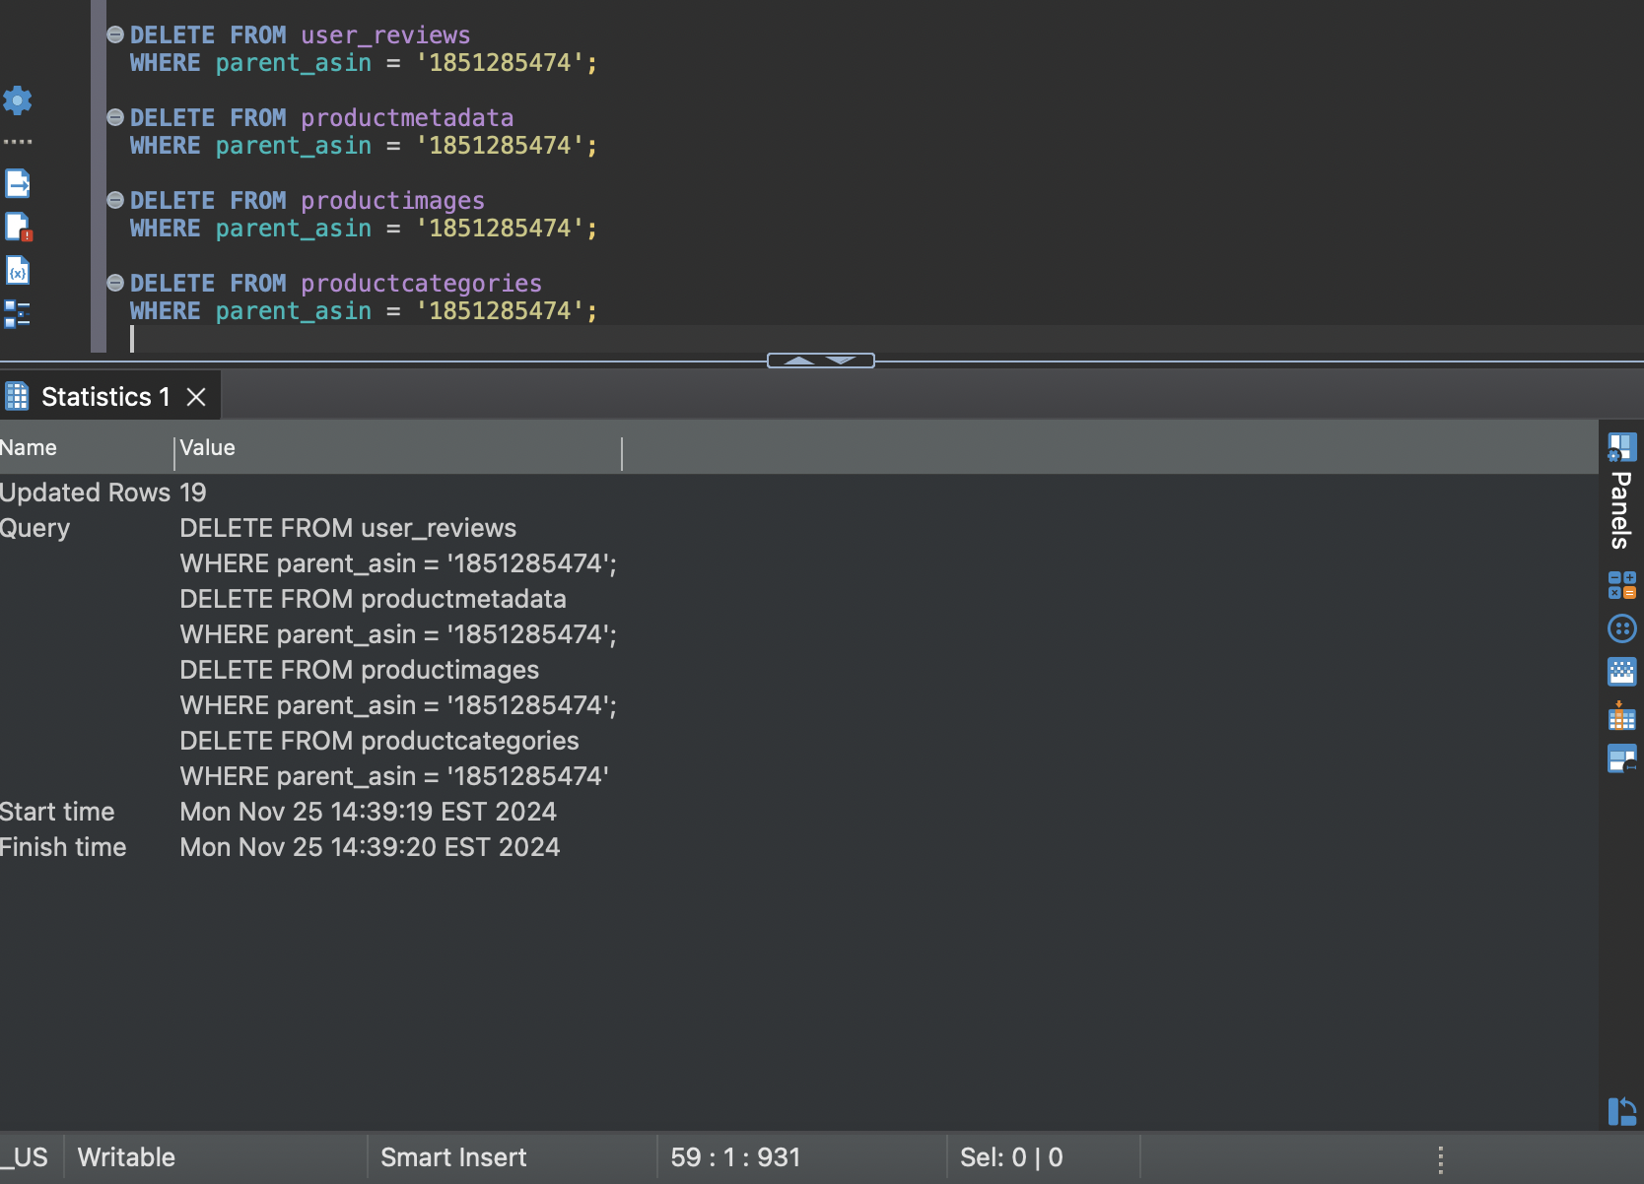
SQL Queries – Removing Data

Slide 8
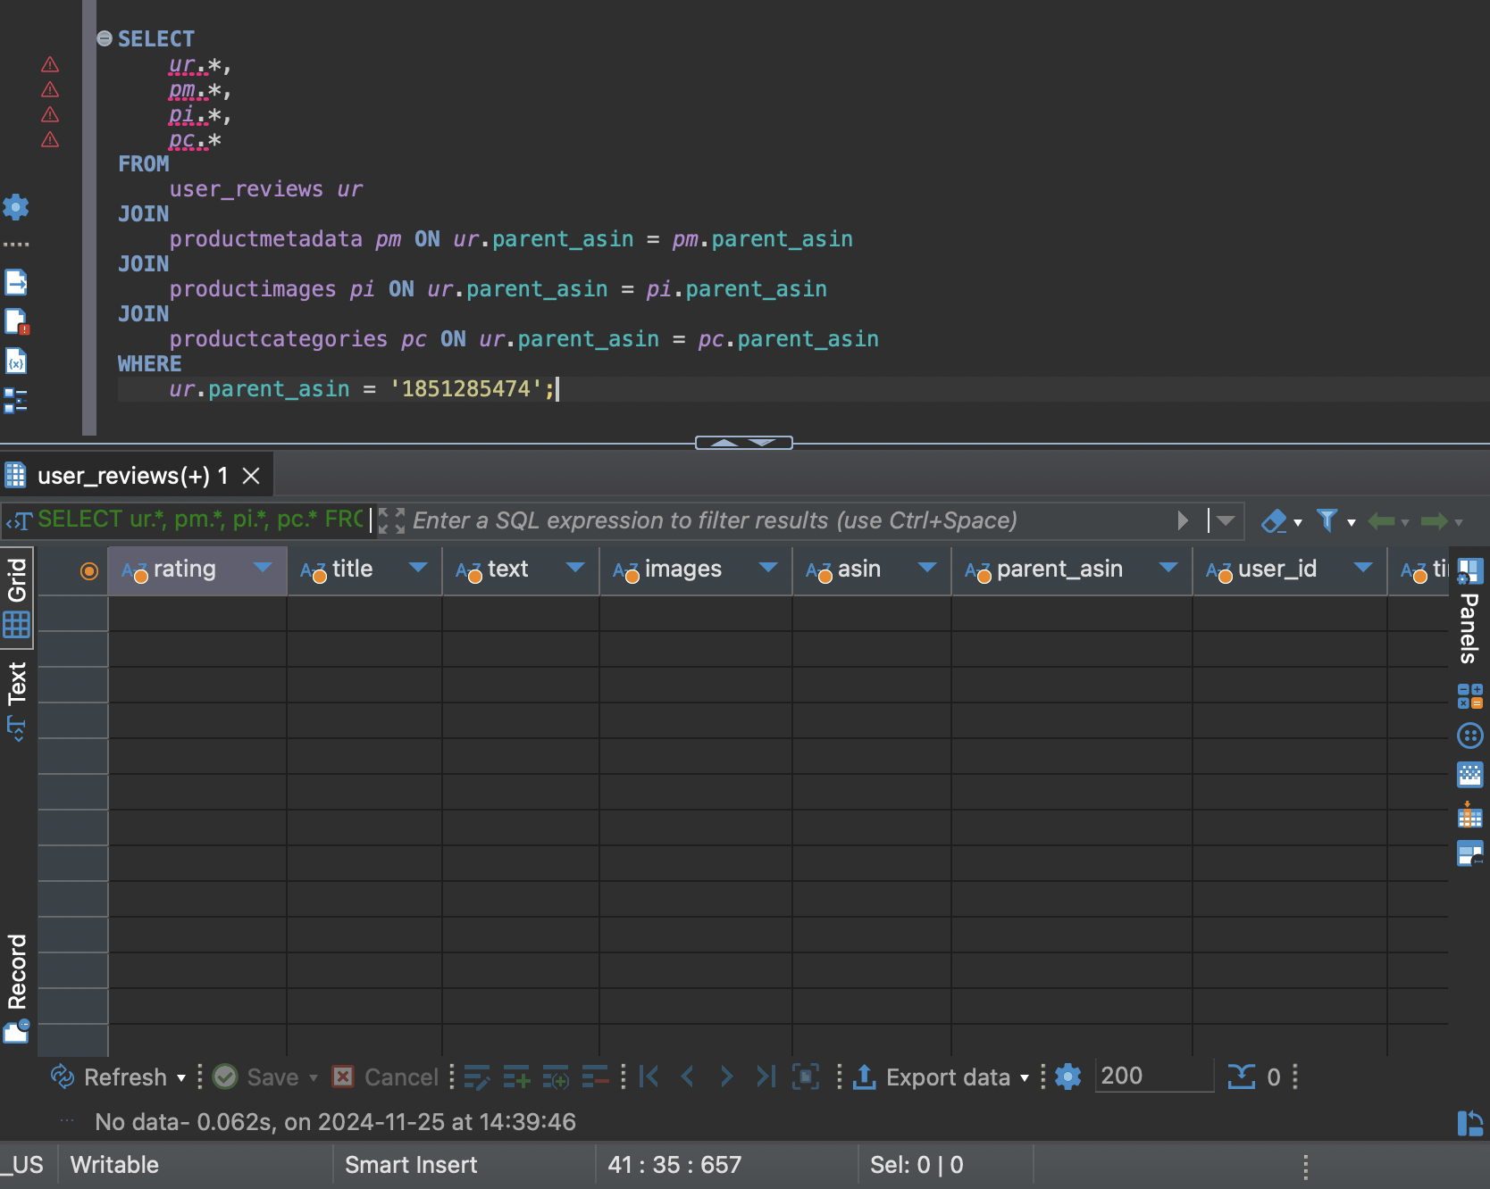
SQL Queries – Retrieving Data After Removal

Slide 9
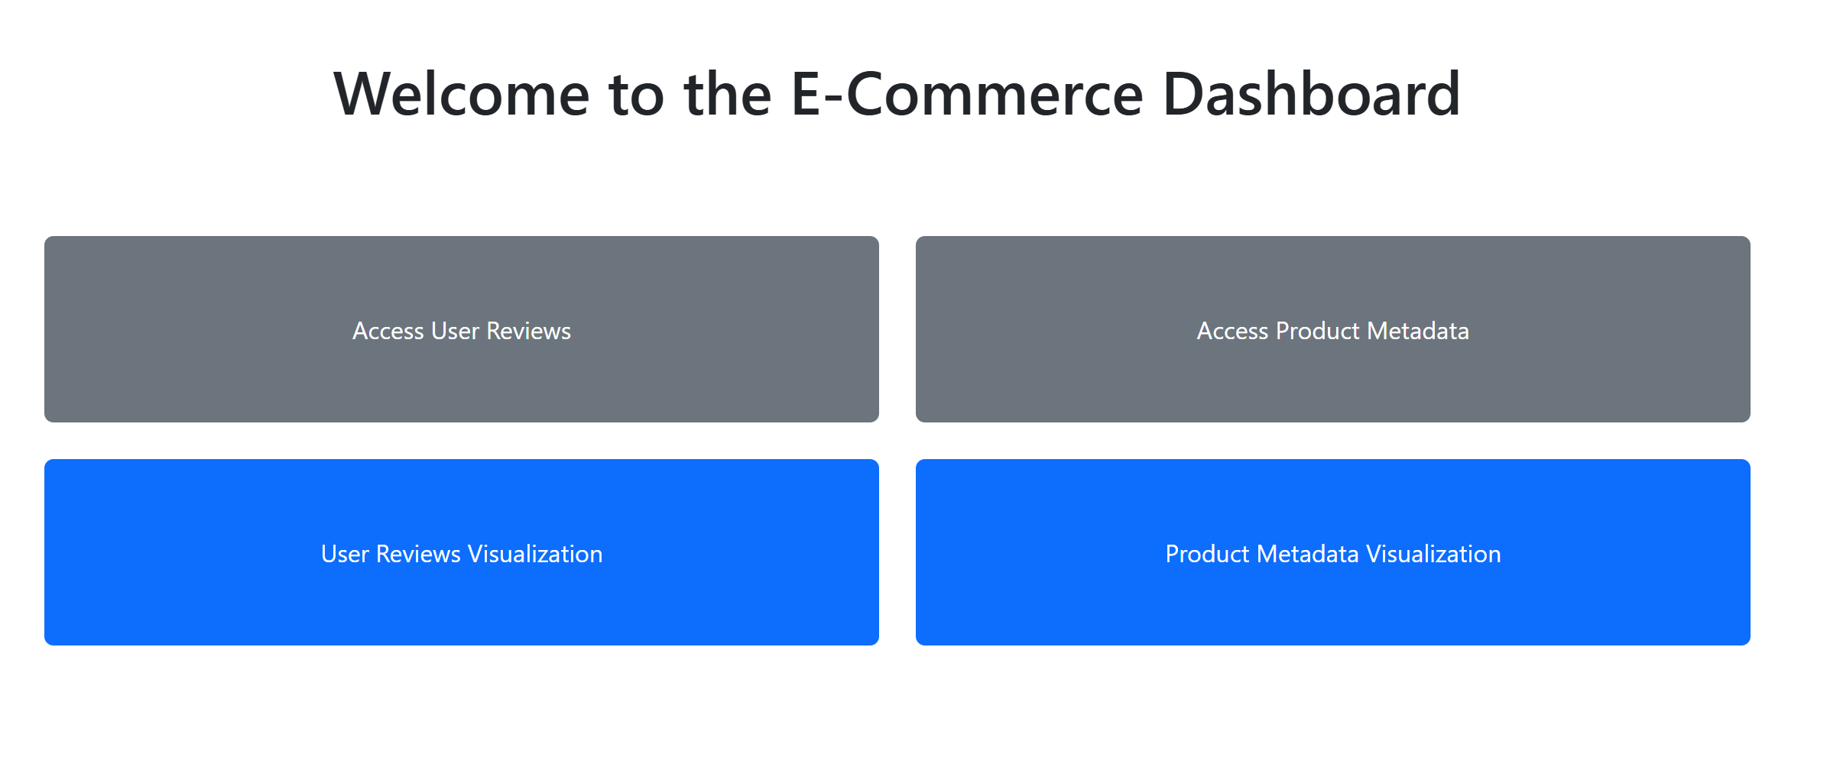
Dashboards – Control Panel

Slide 10
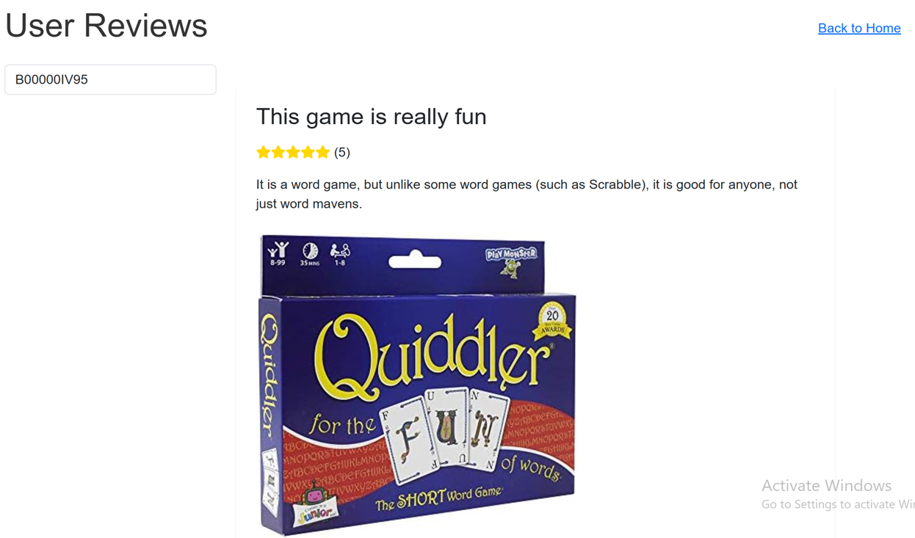
Dashboards – Access User Reviews

Slide 11
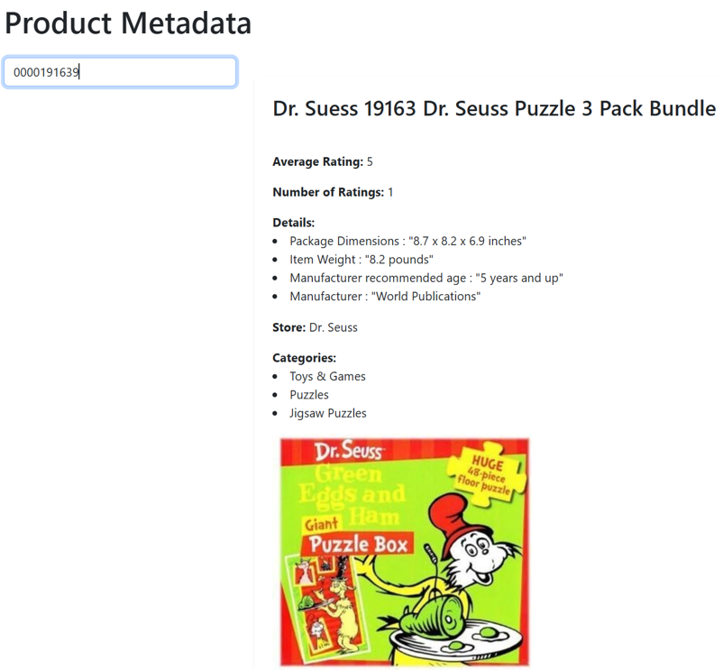
Dashboards – Access Product Metadata

Slide 12
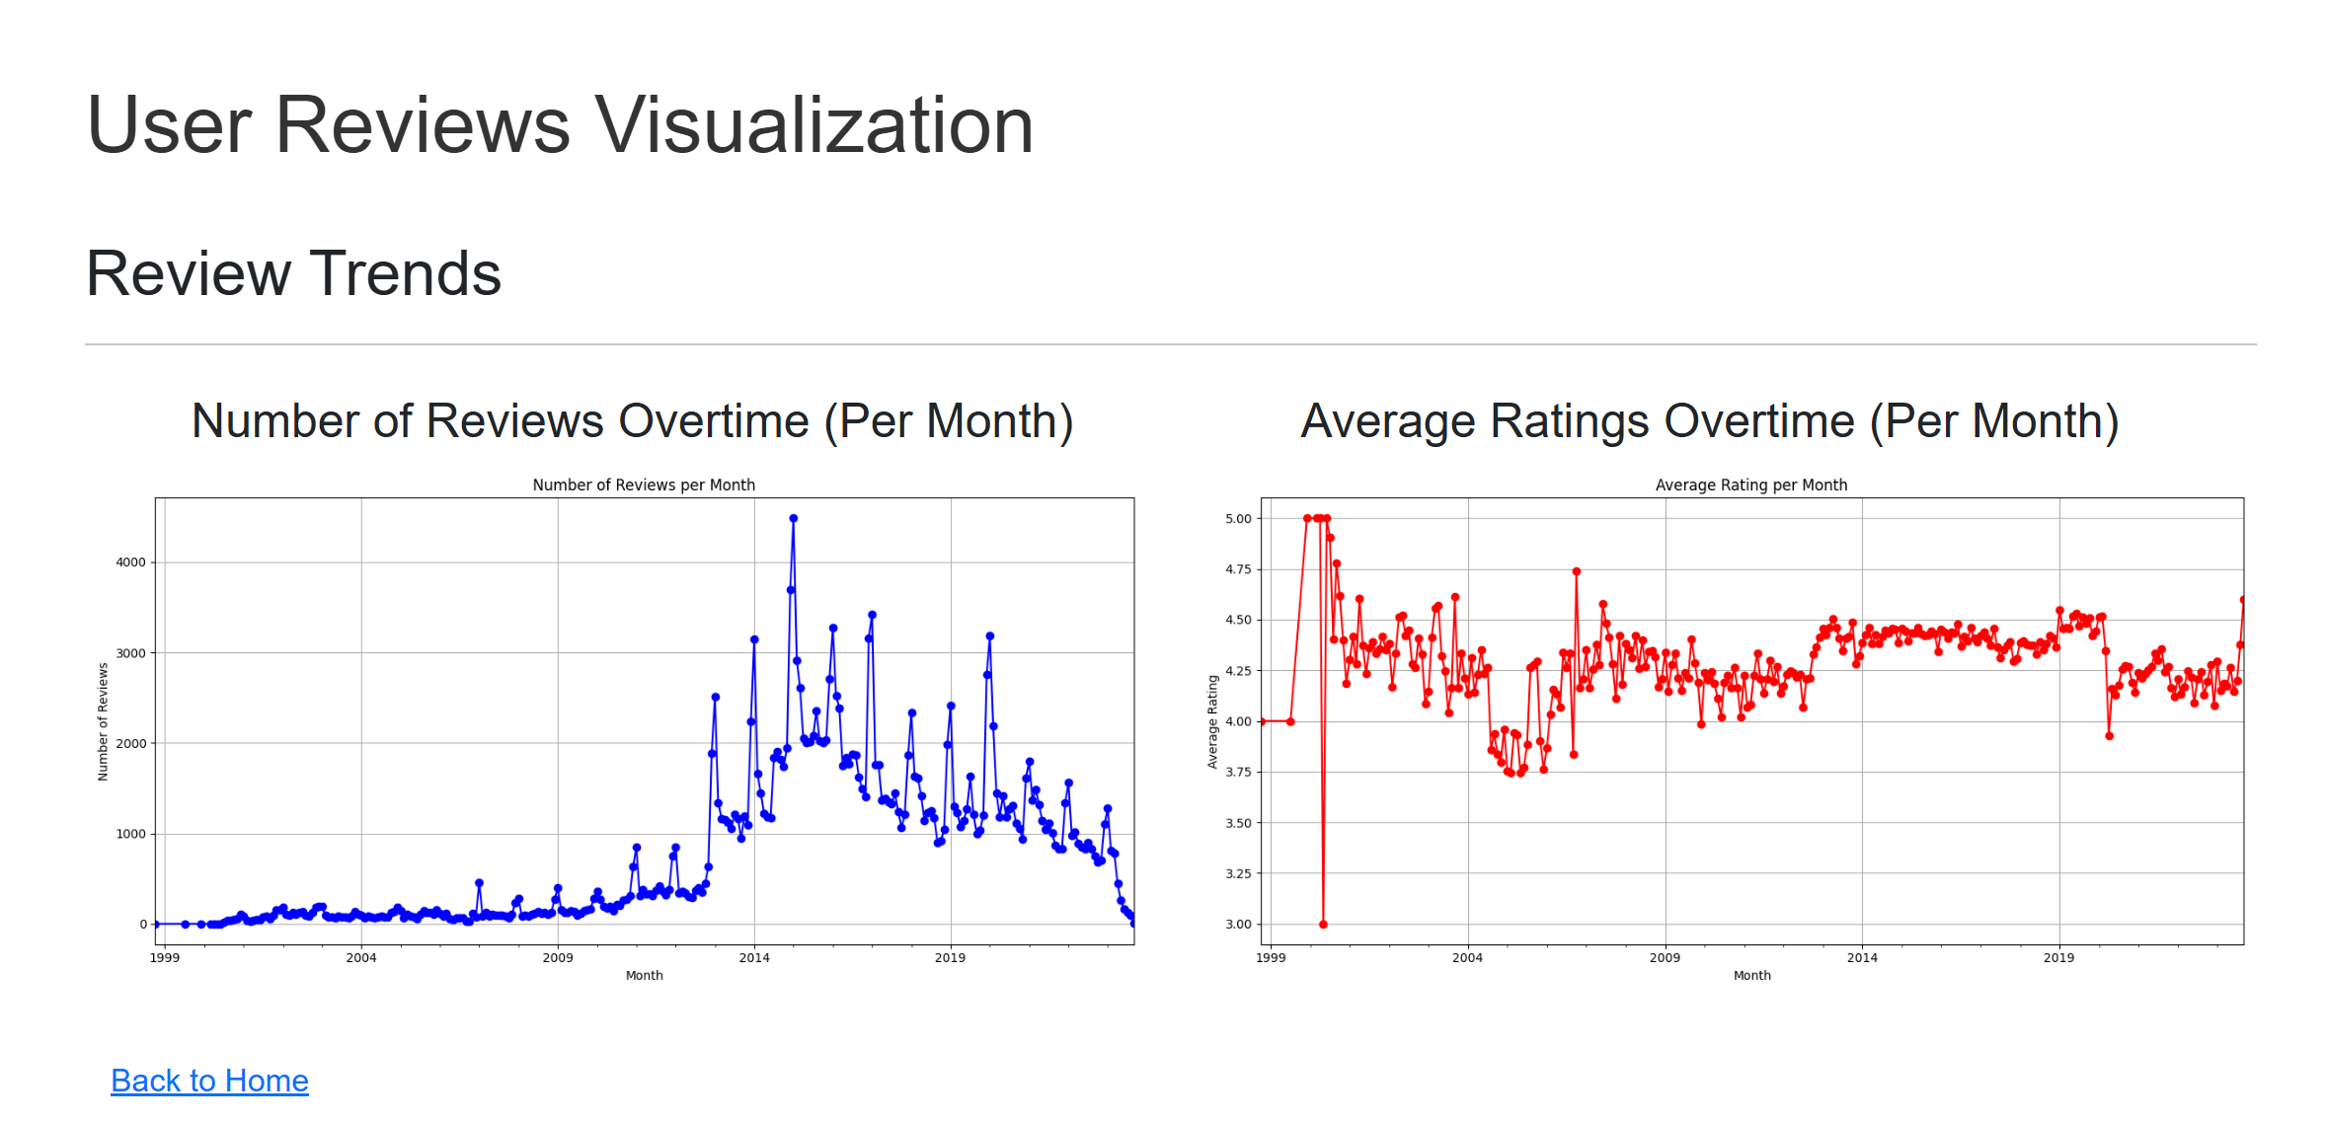
Dashboards – User Reviews Visualization

Slide 13
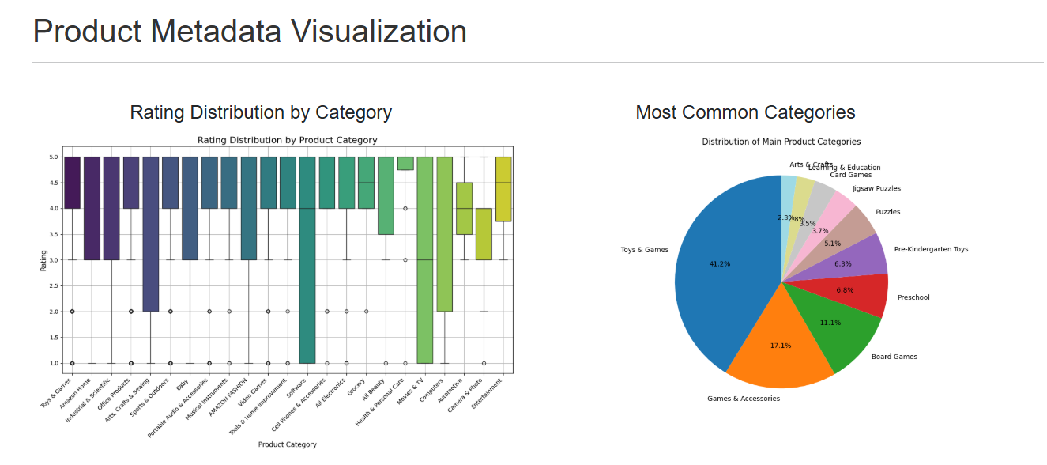
Dashboards – Product Metadata Visualization (1)

Slide 14
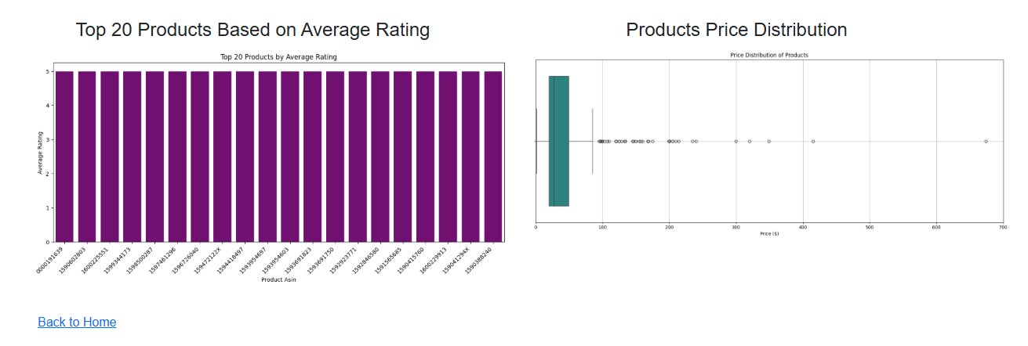
Dashboards – Product Metadata Visualization (2)

Slide 15
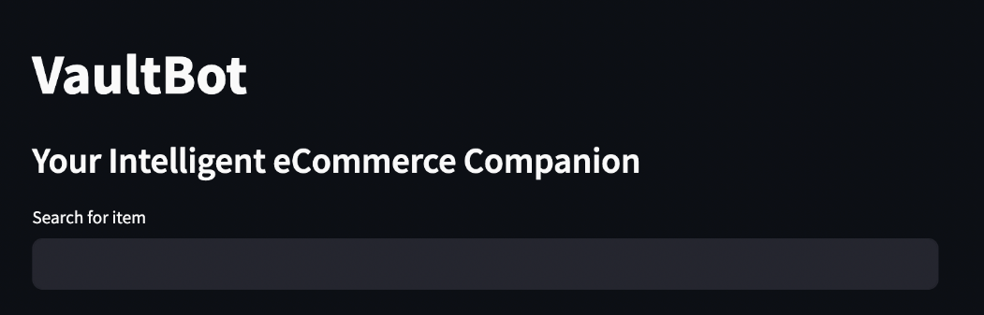
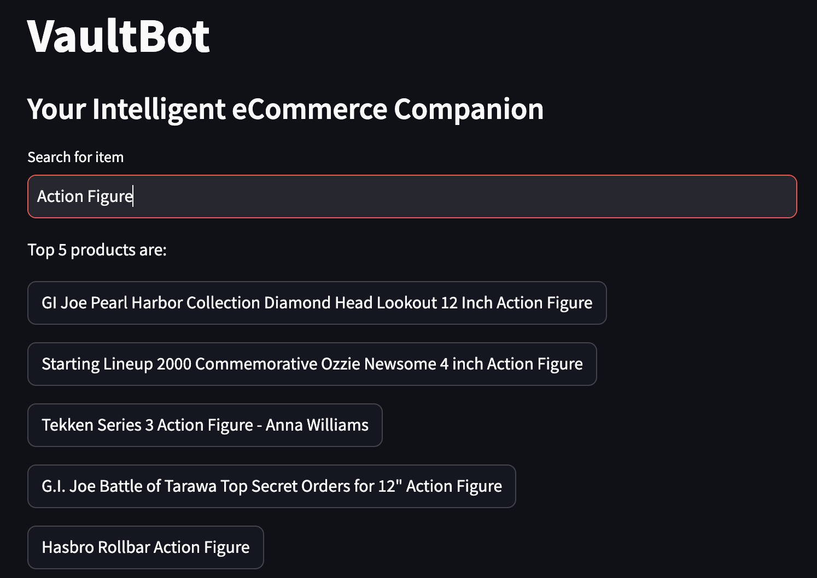
ChatBot

Slide 16
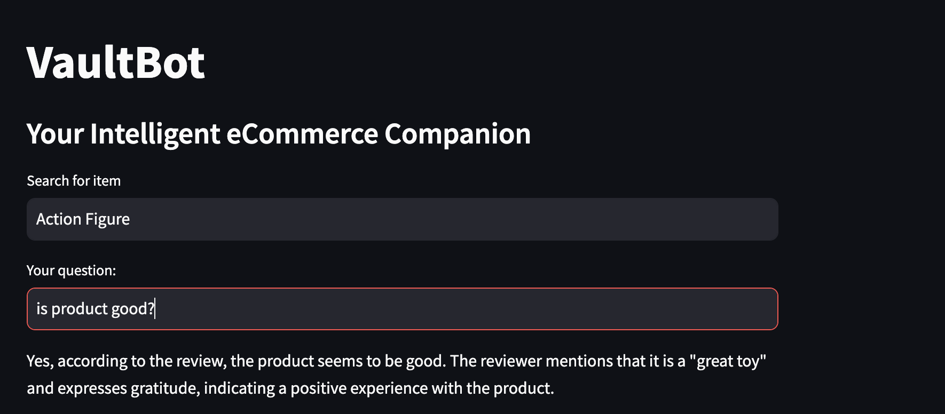
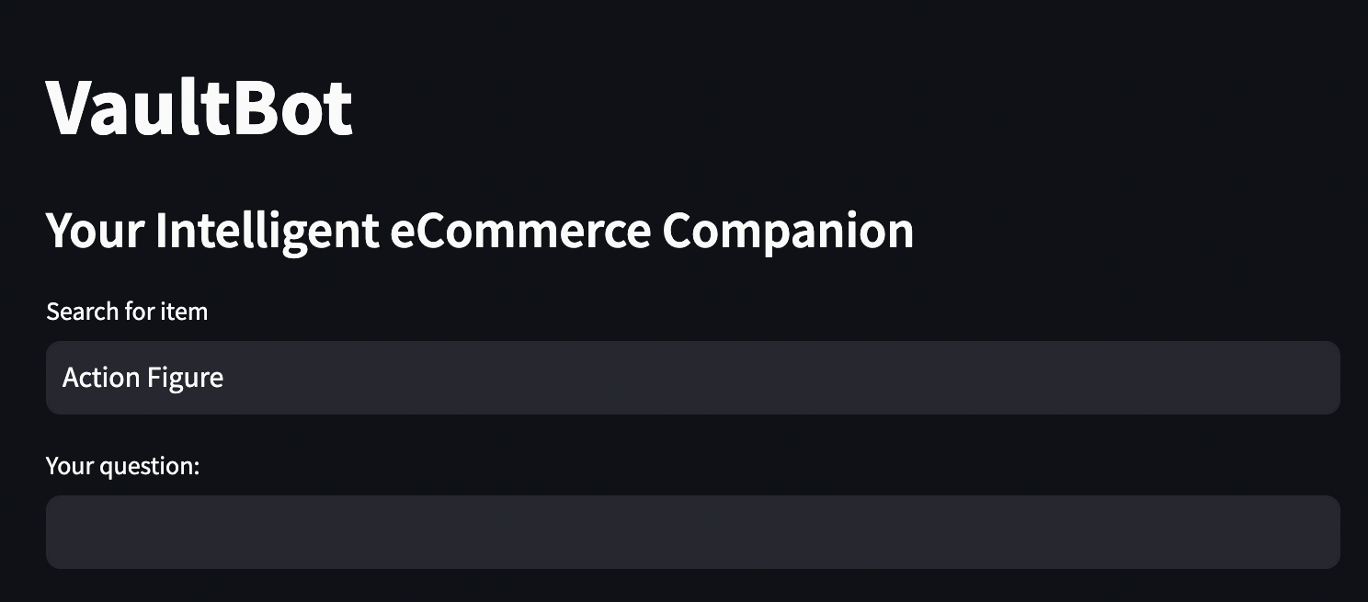
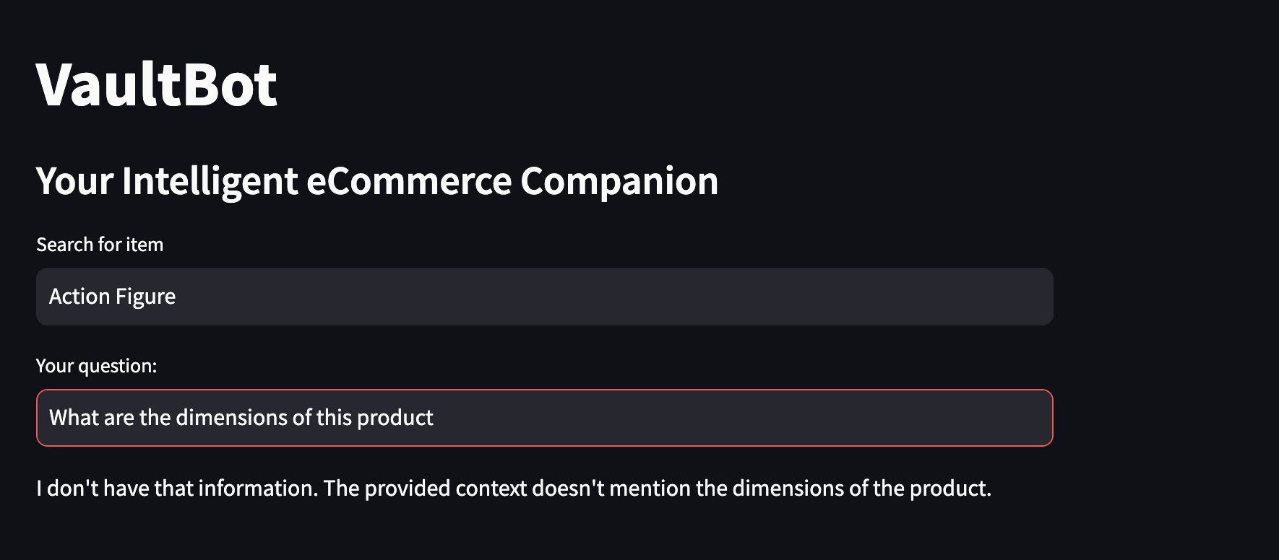
ChatBot

Slide 17


Conclusion
Future Work
Warehouse solution that integrates structured and unstructured data
Enhancing real-time interactivity with Data Dashboards
Adding more features to the ChatBot
Use of automated ETL processes
Valuable data visualization techniques and interactive Dashboards
Creation of a ChatBot to help answer user questions about products
Limited GCP credits, and time

Slide 18
References
• Hou, Yupeng, Li, Jiacheng, He, Zhankui, Yan, An, Chen, Xiusi, and McAuley,Julian. ”Bridging Language and Items for Retrieval and Recommendation.” arXivpreprint arXiv:2403.03952 (2024)
• Chen, H., Chiang, R. H., & Storey, V. C. (2012). Business intelligence and analytics:From big data to big impact. MIS Quarterly, 36(4), 1165–1188. https://doi.org/10.2307/41703503
• Faisal, M. I., Hossain, M. A., & Rahman, M. S. (2020). Automated ETL pipelinefor data integration in cloud data warehousing. Journal of Cloud Computing: Ad-vances, Systems and Applications, 9(1), 34-47. https://doi.org/10.1186/s13677-020-00214-w
• Stonebraker, M., C¸ etintemel, U., & Zdonik, S. (2018). The design of modern datamanagement systems. ACM Computing Surveys, 50(2), 1-41. https://doi.org/10.1145/3184738

Slide 19
Any Questions

